Slide 1


Software Project Major IT447 A. Y. 2021-22
Prepared By:
18IT052:Aditya Lalwani
Guided By:
Internal Guide : Dr. Parth Shah
(HOD, IT)
External Guide : Mr. Sudhir Panchware
(Functional Consultant, TCS)

Slide 2
Stock portfolio project

Slide 3
Outline of the presentation
Abstract
Functional Requirements
Non-Functional Requirements
Tools & Technology Used
Industry Practices
Technical requirements & Project Requirement
Study of Existing Solution
Problems Encountered
Design and Implementation Details
Requirement Details
UML Diagrams
Coding Standards
Learning Outcomes
Demo
References

Slide 4
Abstract
Stocks, even known as equities, represent fractional ownership in a corporation, and the stock market is a platform for investors to buy and sell such investible assets. And a portfolio is a collection of most of an investor's stock market investments in various asset classes. This project is a Portfolio Management System that is used to keep track of stock trading information. This application contains a variety of stock records for managing significant transactions such as stock purchases and sales.
With a portfolio like this, we can simply track and understand the performance of each of our investments. The major objectives of this initiative were to research potential investment possibilities, balance their risks and advantages logically, and make informed investment decisions.

Slide 5
List of functional requirements (Scope of the Project)
Add new portfolio
Add new stocks, its quantity, purchase price
View Summary of all the shares in his portfolio.
View all the different shares, total shares, current price, profit/loss and net profit/loss of the portfolio.
Add different assets like Mutual Funds, Debts etc.

Slide 6
List of nonfunctional requirements
Availability:
Application should be available 24 hours a day.
Security Requirements:
Users’ accessibility is censured in all ways.
Salesforce App security.

Slide 7
Tools & Technology Used
Salesforce
Salesforce technology is based on cloud computing. This Salesforce CRM platform helps us to use it as a web CRM. This is customer success platform making use of all the available technology to help build streamline requirements and satisfy customer’s needs.
Workbench
Workbench is a powerful application that helps developers interacts with their Salesforce data. We have used this technology to Process records asynchronously via Bulk API for insert, update, upsert, delete, export data, and much more.
Salesforce Apex Trigger
Apex is a programming language similar to Java, used to develop and enhance the Salesforce CRM application. We have used this feature to access data from the CRM’s database and manipulate it as well by using an API (application user interface).

Slide 8
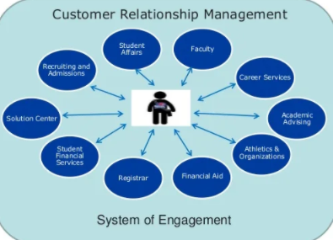
Industry practices adopted while developing the project
Salesforce uses Customer relationship management (CRM) in which a business or other organization administers interactions with customers, typically using data analysis to study large amounts of information. In the Figure it shows that how a Student is engage in an institute via CRM.
Stock & Portfolio Management System that is used to keep track of stock trading information. This application contains a variety of stock records for managing significant transactions such as stock purchases and sales.

Slide 9
Technical requirements
At least 5 GB of RAM, with 2 GB available for Salesforce browser tabs.
An Octane 2.0 score of 20,000 or greater.
Network latency of 200 ms or less.
Download speed of 1 Mbps or greater.

Slide 10
project requirement
User should be able view Summary of all the shared in his portfolio. It should show all the different shares, total shares, current price, profit/loss and net profit/loss of the portfolio.
User should be able to add new shares, its quantity, and purchase and/or sell price to the portfolio.
User should be able to Buy and Sell Shares.
He/She can able to see Profit/Loss Gained by Selling each share
Additionally, user should also be able to see other assets like Mutual funds, Debts, etc.

Slide 11
STUDY OF EXISTING SOLUTION
There are many investing portfolio applications are available on the market. These applications take effort, time, and money to set up and maintain the Portfolios.
So, having a solution that eliminates the need to separately invest in each resource in the investment portfolio while providing the same features is something that anyone would want.
In existence solutions we cannot selling the Stocks, users cannot able to calculate Net Profit gained from that. And to accomplish this, we have created a Salesforce web application that provides the same functionality while providing a better user experience.
We have make use of Workbench to Process records asynchronously via Bulk API for insert, update, upsert, delete, export data, and much more.
While there are many software available on the market, but most of them require hardware/Software requirements. With the help of Salesforce, we can create simple browser based application. We can View and validate the generated output using the Schema Builder.

Slide 12
PROBLEMs ENCOUNTERED
This whole Investment Portfolio works, what formulas are used while calculating profit and how to implement it in Salesforce.
How to Update more than 2000 records asynchronously within seconds and changes done in every other object to calculate profit/loss if the value of current price increases/decreases.
There were many problems occurred while implementing the Coding section as Apex Language is new to us. So, after many trial and error methods we were able to accomplish our Objective.

Slide 13
Design and Implementation Details
Apps, tabs and Objects
validation Rules
Rollup Summary and Formula Fields
Flows
Lookup Filters
Compact Layout
Search Layout
Page Layout
Apex Trigger
Related Lists
Workbench

Slide 14
REQUIREMENT DETAILS
ADD NEW PORTFOLIO
User can Create or Update many portfolio according to his need. Adding a new portfolio means that user can assign different members of whom he is managing the portfolio.
This Portfolio shows many details such as it belongs to which user, total investment done by the user, current value of all the purchased shares, Net gained profits/losses from these shares and total profit/loss gained by selling the Shares.
ADD/UPDATE STOCKS
Stocks are updated on daily basics via workbench. User could able to see different Stock lists with their type such as equity, book entry, government securities and many more. Besides that user can see the current price of the Shares and High, Low, Open, Close and Last Trading Price of all the Shares of the Day.
As these Stocks varies the profit gained in the Portfolio also changes via triggers in Salesforce.

Slide 15
Cnt…
BUY/SELL STOCKS TO ASSET TRANSACTION
User can Buy new shares and add details like Name, number of shares, purchase/ Sold, transaction date, transaction price. To buy any Stock user has to Select a Stock from the Asset and also select a portfolio in which he/she want to add the asset. User also has to mention the Quantity he/she wants to buy.
After Buying the stock new asset transaction will be created in which the purchased amount, total Expanse and average transaction price will be calculated and new record in Owned Asset will automatically create for successful transaction. To Sell any Stock User has to confirm that the Stock must be in Owned Asset object and its quantity must me less than or equal to owned assets quantity.
OWNED ASSETS
Purchased Share will be shown here with Net Profit of each share. When any Purchase Transaction is pushed in asset transaction object that purchased stock will automatically be entered in Owned Asset object. This object will now fetch current price of the asset and then calculate the profit according to the purchased price.
SOLD ASSETS
Sold Shares will be shown here with total income gained of each share. When any Selling Transaction is pushed in asset transaction object that Sold stock will automatically be entered in Sold Asset object.

Slide 16
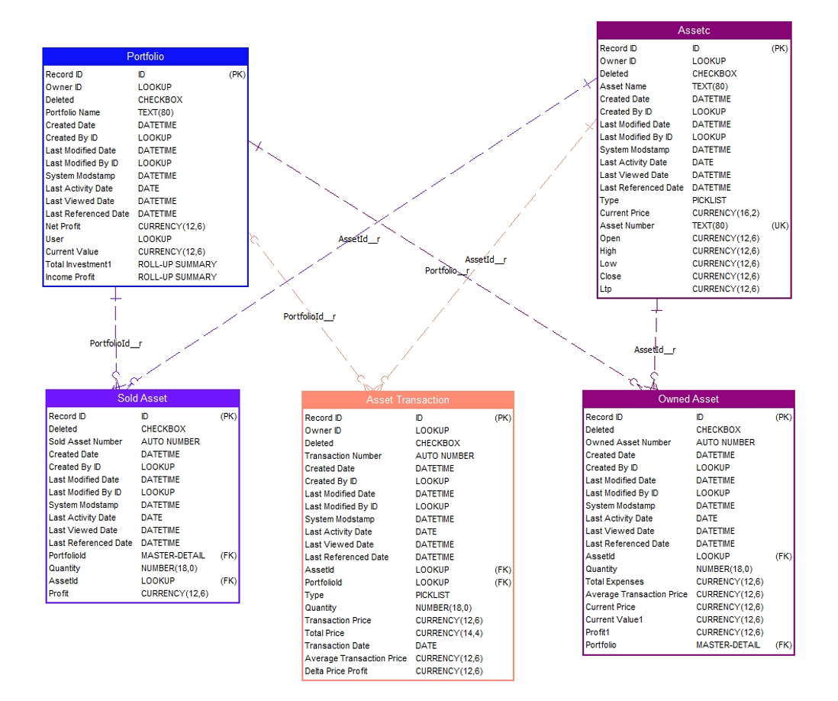
Entity - Relationship diagram

Slide 17
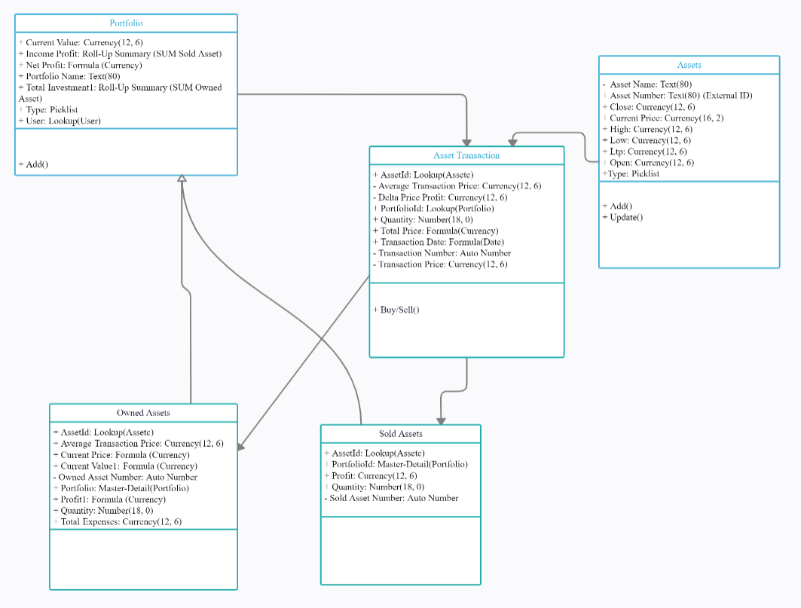
CORRELATION OF ENTITY

Slide 18
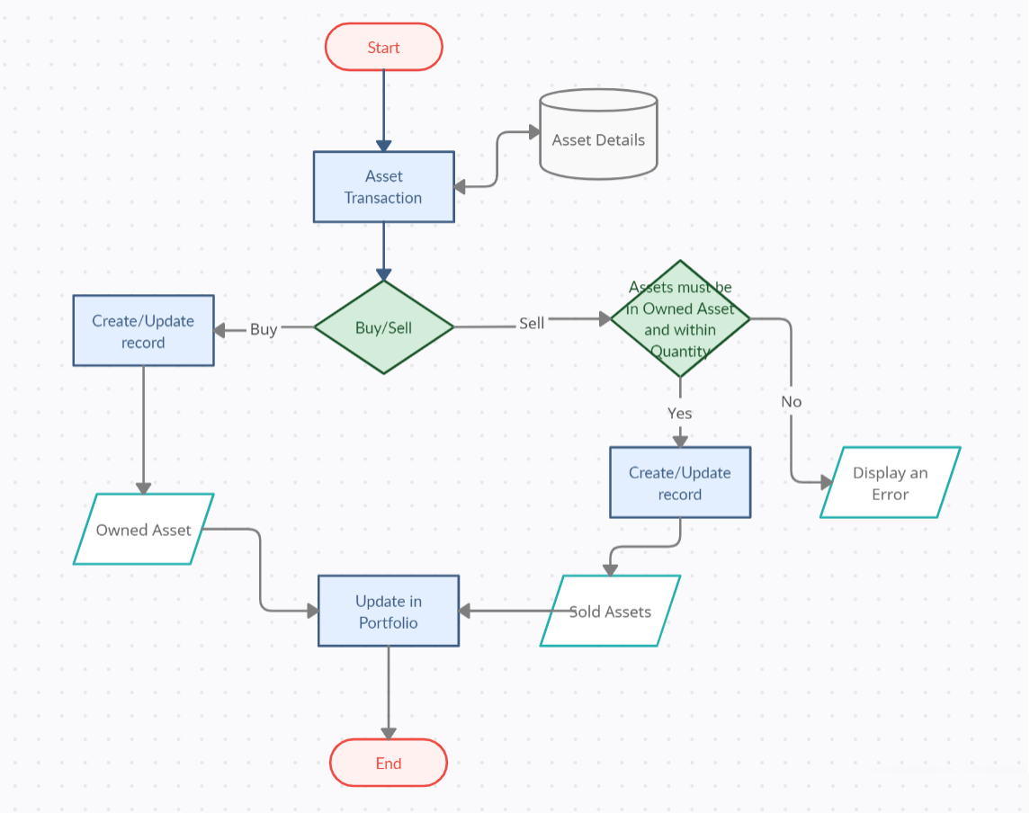
FLOW OF THE PROJECT

Slide 19
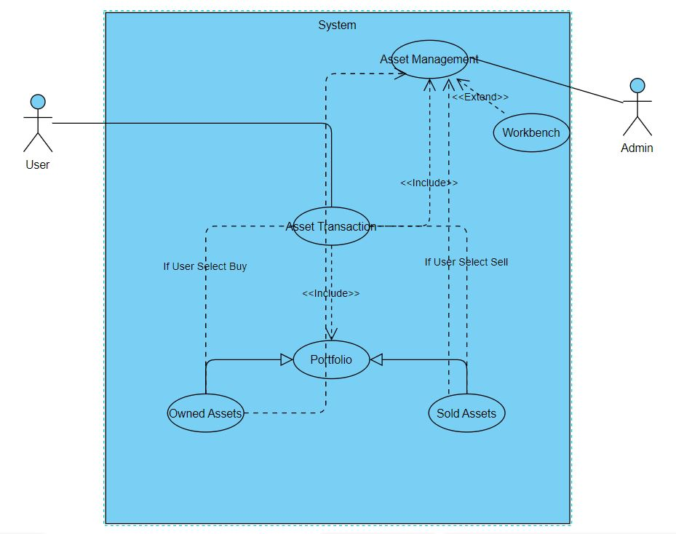
USER REQUIREMENTS

Slide 20
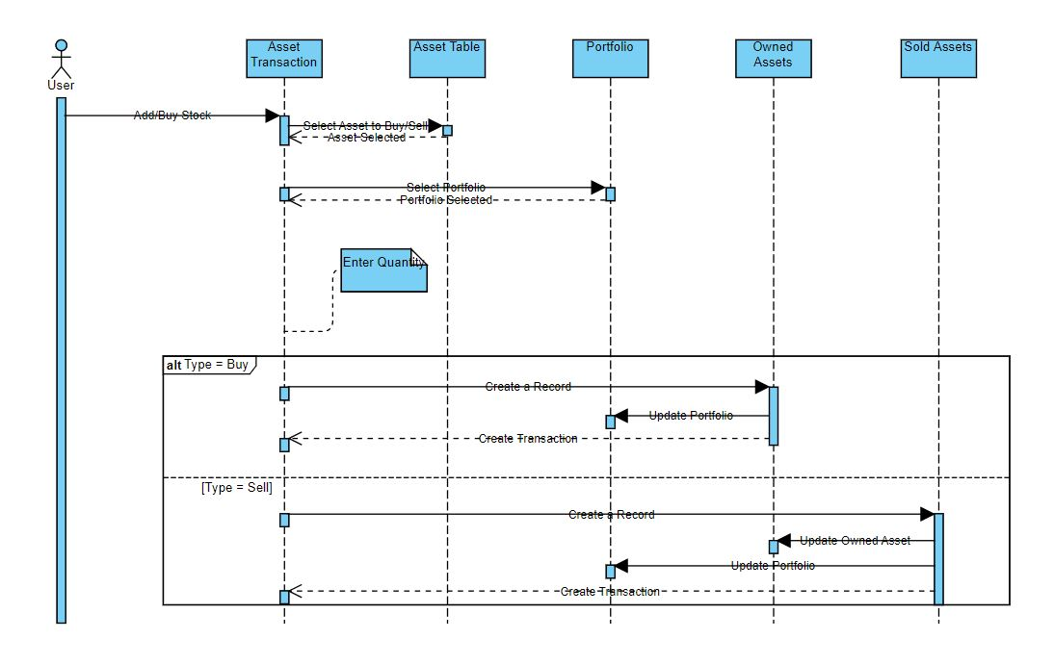
USER INTERACTION WITH OBJECTs

Slide 21
CODING STANDARDS
Name your files logically according to the job that they perform.
Clean code is a self-commenting (using the right variable and function names).
Use comments and only to explain complex functions.
Reusing code in several places, should be replaced with a single method and reduce the clutter in the code base.
Do not put DML in loops, DML means any insert, update, delete, undelete, merge, convertLead transaction.
Only use one trigger per object, having multiple triggers across the same object greatly increases the complexity of your Salesforce org.
Keep logic outside of triggers, Triggers should only contain a handful of lines of code, used for calling methods

Slide 22
Further planning for Project
This project is still in developing phase. It has multiple customizations based on the Customer requirements and feedbacks.
API to change current Price on seconds basis.
Adding Mutual Funds, Debts in the Same Portfolio.
It needs work on Analytics‟ and user interaction.

Slide 23
Learning outcome till date
Salesforce Admin
Salesforce Developer
Apex Language (Classes, Triggers, LWC, Visualforce, DML, SOQL, SOSL, Testing)
How Salesforce manages CRM in project
Reports and Dashboards
Stock Management
Workbench
Learned a lot from Mentors Guidance, helpful that made my learning fruitful
Collaboration with Coworkers

Slide 24
DEMO

Slide 25
References
https://www.sfdcpoint.com/salesforce/apex-trigger-in-salesforce/
https://gist.github.com/KorbenC/24f04b4d0f4bcf65ce5a
https://docs.google.com/spreadsheets/d/17yNbjwIy_8Ngp2HgKKc57njrEMhujfaC-jjx1Xih_cI/edit?usp=sharing
https://www1.nseindia.com/products/content/equities/equities/archieve_eq.htm
https://developer.salesforce.com/docs
https://help.salesforce.com/s/
https://trailhead.salesforce.com/content/learn/modules
https://www.visual-paradigm.com/
https://creately.com/
https://workbench.developerforce.com
https://studyportals.com/blog/the-importance-of-customer-relationship-management-crm-systems-in-higher-education/

Slide 26
Thank You

